Slide 1
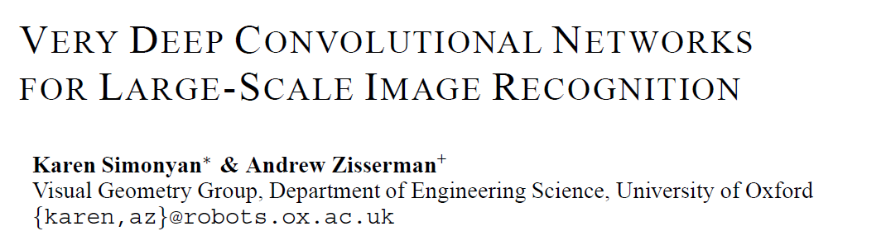

Slide 2

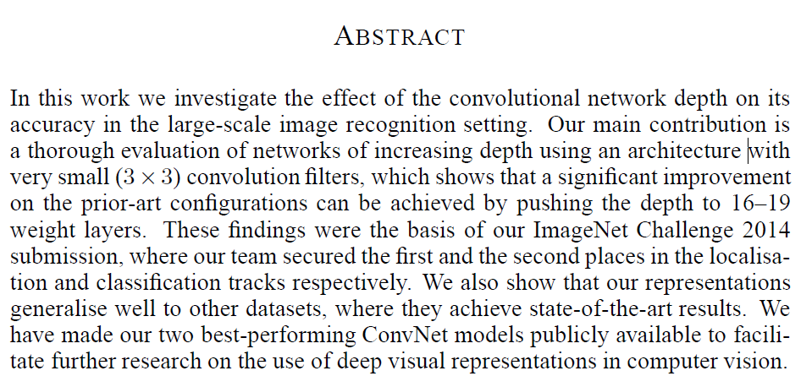
Effect of the convolutional network depth on its accuracy in the large-scale image recognition setting.
Evaluate networks of increasing depth using an architecture with very small (3×3) convolution filters
What are the two ConvNet models?

Slide 3
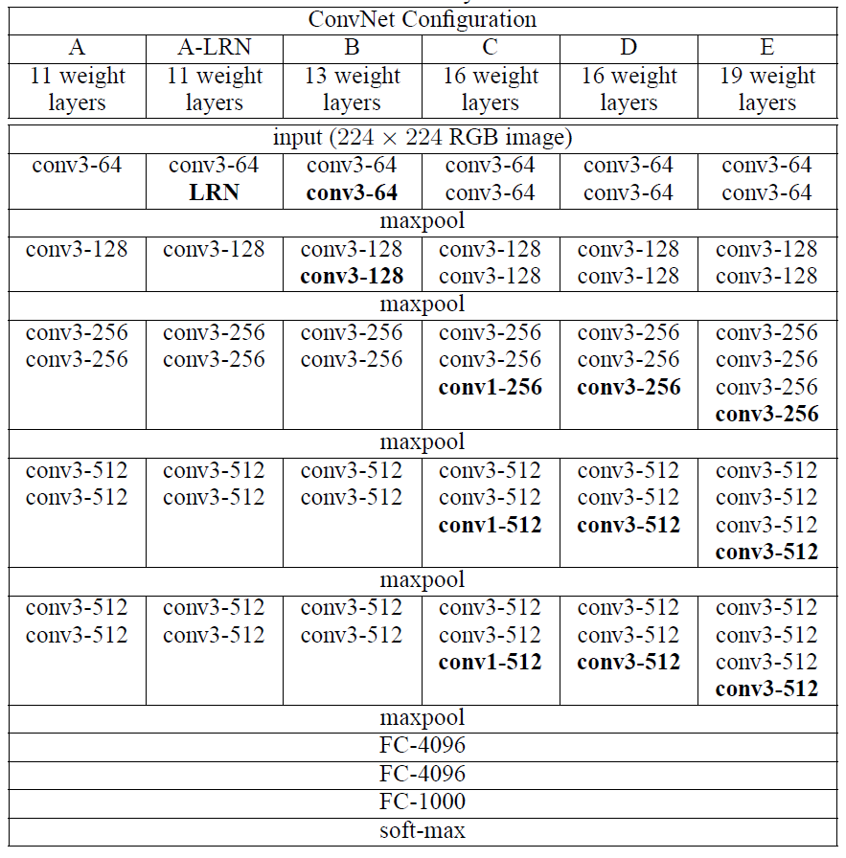
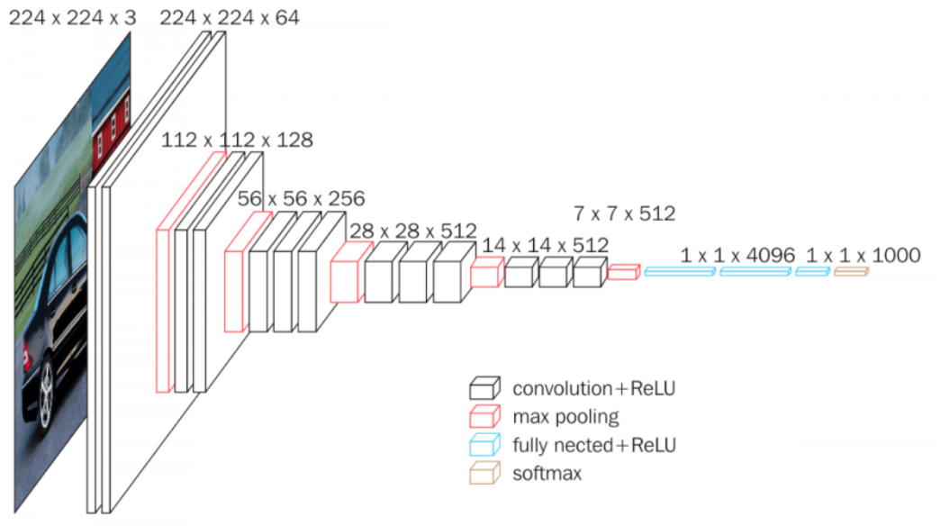
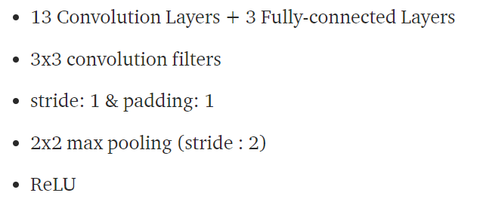
The weight corresponds to the size of the filter.
conv3 = 3x3 filters, conv1 = 1x1 filters,
N = the number of filters in conv3-N
for example, conv3–64 = 64 3x3 filters

Slide 4
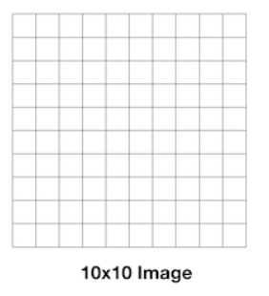
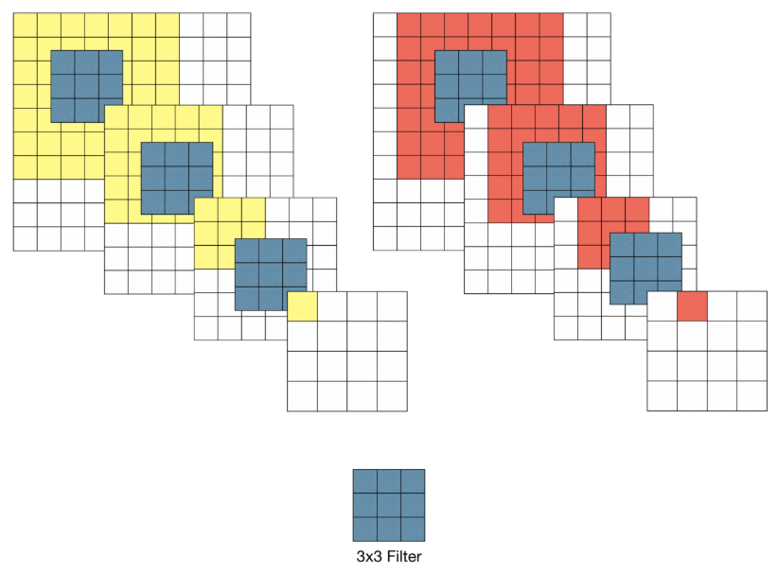
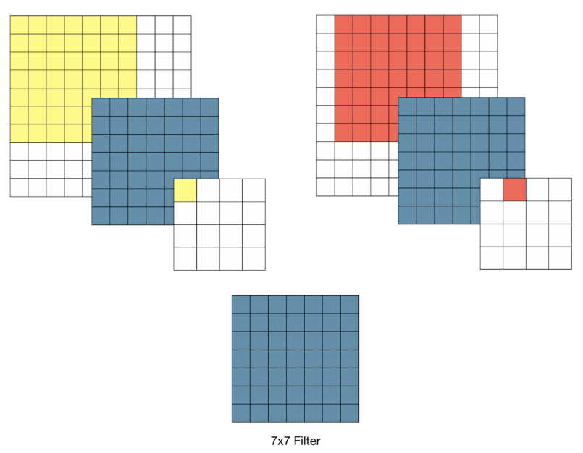
3x3 filter
Increased nonlinearity of functions
Reduced number of learning parameters

Slide 5

It can be seen that the accuracy of image classification increases as the depth of the network increases.
The reason why the depth of the network was used up to 19 layers in the experiment was because the error rate converged in VGG-19.
Deeper models may be more useful if you have a large set of training data.

Slide 6
Prevent overfitting
When training the model, the size of all input images was fixed to 224x224.
You can increase the number of limited data. — Data augmentation
Various aspects of an object can be reflected.
The smaller the transformed image, the more you can learn the whole aspect.
The larger the transformed image, the more specific part of the object can be reflected in learning.

